Slide 1

Cloud based implementation: Geo-Crawler
Prepared by
Deepak Punjabi (15IT60R17)
Bhumi Faldu (15IT60R18)
Mayank Gautam (15IT60D04)
Under Guidance of
Professor Soumya K. Ghosh
Notes:
This is a note

Slide 2
Building a cloud based implementation
for a
spatial web crawler
that crawls through the web to
find and store
web feature services
classify and index them for efficient retrieval.
Problem Definition

Slide 3

Objectives
Implementing a cloud based architecture to build and efficient web crawler.
Building a spatial web crawler using WFS based on OGC standard.
Building a domain ontology with spatial feature type.
Semantic matching using ontology and indexing of geo-servers with offered feature type reference.
Performing experiment with test seed URLs and analysing the performance of the crawler in terms of accurate semantic annotations.

Slide 4

Solution Methodology
Master-Worker Approch
One master, multiple worker
Master manages workers
Task is divided into multiple smaller tasks by master
Master assigns task to worker and keep track of the work state
All workers run this task parallel
Master does the synchronization between the workers
Map-Reduce Approach
Framework includes two types of nodes, mapper nodes and reducer nodes
Mapper node crawls through URLs to fetch and filter URLs and store them into list
Reducer node checks if the URL belong to a geo-server
If yes, then it extracts the feature metadata from the server and stores it into the repository

Slide 5
Seed URLs
Extraction Module
Get FeatureTypeList
Ontology
Initialize
Enqueue
Remove duplicate URL
List of features
URLQueue
Extract
Hyperlinks
Parse FeatureTypeList
Check <Name>, <Title>, <Keyword>
Perform semantic match
Extract URLs
Filter
Stage
Parser
Parse
Source page
Yes
For all feature
Feature
definition
Found in ontology
Remove checked
DescribeFeatureType
Match found?
WMS
Resolver
WFS Module
Add to persistence
storage
Geo
Server?
GetCapabilities()
Analysis & Indexing Module
Repository
Spatial Crawler Architecture

Slide 6


Result Metric
Here
text
Re
Final score is calculated by taking average over all feature types.

Slide 7
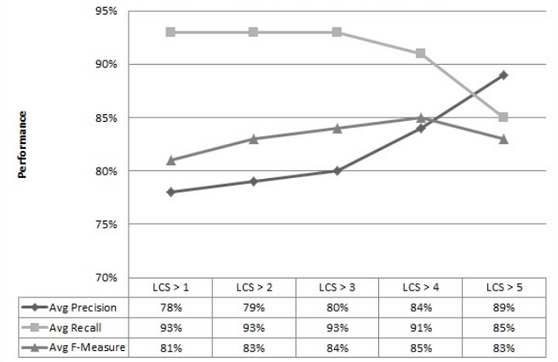
Performance based on LCS threshold
source: patil et al, springer 2014

Slide 8
Conclusive Thoughts
In the recent era, need of storing and retrieving sptial data and feature is a necessity
To retrieve sptial data, it is necessary to understand it’s feature and operations
To cater the need of spatial data, crawler based approach is implemented
Cloud based approch can be followed for the implementation using both master slave and map reduce approach.
Massive parallelization can be applied to cater the peformance need for the crawler.
Cloud based approach provides cost effective and scalable archi-tecture. It satisfies the economy of scale.

Slide 9

References
Patil, Sonal, Shrutilipi Bhattacharjee, and Soumya K. Ghosh. "A spatial web crawler for discovering geo-servers and semantic referencing with spatial features." Distributed Computing and Internet Technology. Springer International Publishing, 2014. 68-78.
Li, Wenwen, Chaowei Yang, and Chongjun Yang. "An active crawler for discovering geospatial web services and their distribution pattern–a case study of OGC web map service." International Journal of Geographical Information Science 24.8 (2010): 1127-1147.
Jiang, Jun, Chong-jun Yang, and Ying-chao Ren. "A spatial information crawler for opengis wfs." Sixth International Conference on Advanced Optical Materials and Devices. International Society for Optics and Photonics, 2008.
Marc Najork. “Web crawler architecture.” Microsoft Research.
Ahlers, Dirk, and Susanne Boll. "Location-based Web search." The Geospatial Web. Springer London, 2009. 55-66.
Li, W., et al. "Semantic-based web service discovery and chaining for building an Arctic spatial data infrastructure." Computers & Geosciences 37.11 (2011): 1752-1762.
Suakanto, Sinung, et al. "Building crawler engine on cloud computing infrastructure." Cloud computing and social networking (ICCCSN), 2012 international conference on. IEEE, 2012.
Bahrami, Mehdi, Mukesh Singhal, and Zixuan Zhuang. "A cloud-based web crawler architecture." Intelligence in Next Generation Networks (ICIN), 2015 18th International Conference on. IEEE, 2015.

Slide 10
Thanks!
Any questions ?

